Slide 1
Unit 6
Lecture 3

Slide 2
Crest Speed, Average Speed and Schedule Speed of Train
Crest Speed: The maximum speed attained by the vehicle during the
run is known as crest speed.
Average Speed: The mean of the speeds from start to stop i.e., the
distance covered between two stops divided by the actual time of run
is known as average speed.
Mathematically ,
average speed = Distance between stops/Actual time of run, T
Schedule Speed: The ratio of distance covered between two stops and
total time of run including time of stop is known as schedule speed.
Mathematically ,
schedule speed = Distance between stops/ (Actual time of run + stop time)

Slide 3
Factors Affecting Schedule Speed of Train
The schedule speed of a given train when running on a
given service (i.e., with a given distance between) is
affected by the following factors:
Acceleration and braking retardation.
Maximum or crest speed.
Duration of stop.

Slide 4
Effect of Acceleration and Braking Retardation
For a given run and with fixed crest speed the increase in acceleration will result in decrease in actual time of run and, therefore, increase in schedule speed.
Similarly increase in braking retardation will affect the schedule speed.
Variation in acceleration and retardation will have more effect on schedule speed in case of shorter distance run in comparison to longer distance run.

Slide 5
Effect of Maximum Speed
For a constant distance run and with fixed acceleration and retardation the actual time of run will decrease, and therefore, schedule speed will increase with the increase in crest speed.
The effect of variation in crest speed on schedule speed is considerable in case of long distance run.

Slide 6
Effect of Duration of Stop
For a given average speed the schedule speed will increase by reducing the duration of stop.
The variation in duration of stop will affect the schedule speed more in case of shorter distance run as compared to longer distance run. It is because stops in case of urban and suburban services are kept very small (say 15 to 20 seconds).
When the distance between stations is much larger and duration of actual run is long as in case of main line service, station stop has less conspicuous effect on the schedule speed.

Slide 7
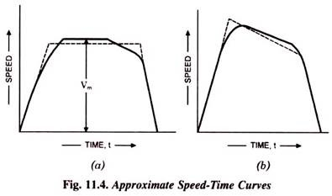
Simplified Speed-Time Curves of Train

Slide 8
Simplified Speed-Time Curves of Train(contd)
In order to study the performance of a service at different schedule speeds the speed-time curves are replaced by simple geometric shaped curves.
From these simplified curves the relationships between acceleration, retardation, average speed and distance can be easily worked out.
These can have either quadrilateral or trapezoidal shape.
The speed-time curve of an urban service can be replaced by an equivalent speed-time curve of simple quadrilateral shape while the speed-time curve of a main line service is best and most easily replaced by a trapezoid.
Since the area of the speed- time curve represents the total distance travelled hence the areas of the two curves should be same.
The values of acceleration and retardation are also kept the same as those of the original speed-time curve.
In case of simplified trapezoidal speed-time curve, speed curve running and coasting periods are replaced by constant speed period, as illustrated in Fig. 11.4 (a) while in case of quadrilateral speed-time curve, initial acceleration and coasting periods are extended, as illustrated in Fig. 11.4 (b).

